Slide 1



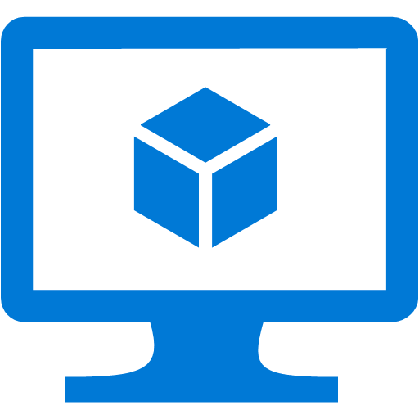
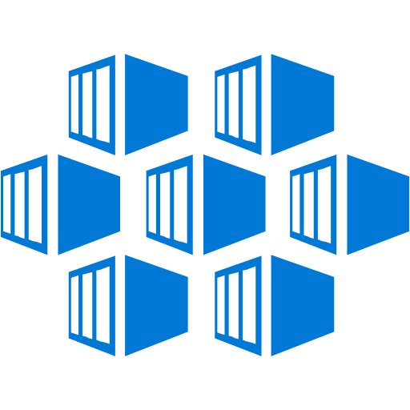

Demo Scenario – Docker ²
Build
Test
Publish
Code + CICD YAML
Azure Pipelines - Build
DockerHub
npm build
npm test
Docker build
Docker push
Self-hosted VM
node:8.15-jessie
ubuntu16-docker
Deploy
Azure Pipelines - Release
Self-hosted on AKS
kubectl apply
AKS - Application
AKS – devops Agents
Azure
Container Jobs - let you isolate your tools and dependencies inside a container.

Slide 2
References
Run devops agent in Docker: https://docs.microsoft.com/en-us/azure/devops/pipelines/agents/docker?view=azure-devops
YAML Schema: https://docs.microsoft.com/en-us/azure/devops/pipelines/yaml-schema?view=azure-devops&tabs=schema#step-templates
Container Jobs: https://docs.microsoft.com/en-us/azure/devops/pipelines/process/container-phases?view=azure-devops&tabs=yaml
Kubernetes Helm chart for devops agent pool: https://github.com/Azure/helm-vsts-agent

